Slide 1

OOP & File Handling in C++
A visual, beginner-friendly guide to Object-Oriented Programming, practical code examples, and persistent data management

Slide 2

Core OOP Concepts
Understanding real-world modeling using C++ Classes and Objects

Slide 3




The 4 Pillars of OOP
1. Encapsulation
2. Abstraction
Bundling data (variables) and functions into a single unit (class) while restricting direct access using private and public specifiers.
Hiding background details and complex implementations, revealing only essential interfaces to the user for simplicity.
3. Inheritance
4. Polymorphism
Creating new classes from existing ones, enabling code reusability and hierarchical relationship modeling.
Allowing functions or objects to take multiple forms (e.g., function overloading and virtual function overriding).

Slide 4
Classes and Objects
Class as a Blueprint: A class defines what data members and methods an object will have (e.g., a Car blueprint specifying color and speed).
Object as an Instance: An object is a real-world entity created from the class blueprint, occupying actual memory space.
Access Specifiers: Controls member visibility. Private members are accessible only inside the class, while Public members form the interface.
Constructors & Destructors: Special functions executed automatically when an object is created or destroyed for setup and cleanup.

Slide 5

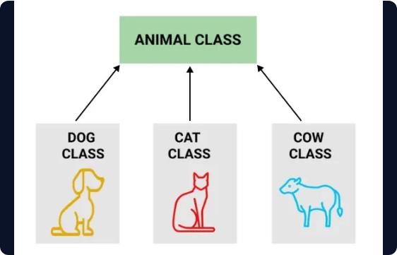
Inheritance & Polymorphism
▸
Base & Derived Classes: Derived classes inherit attributes from a base class using simple syntax: class Student : public Person.
▸
Function Overriding: Redefining a base class method inside a derived class to provide custom behavior.
▸
Virtual Functions: Using the virtual keyword enables dynamic binding (runtime polymorphism).
▸
Cleaner Code Architecture: Keeps your code organized, modular, and easy to maintain as systems grow.

Slide 6
File Handling in C++
Saving data permanently using C++ Input/Output File Streams

Slide 7






C++ Stream Classes
ofstream
ifstream
fstream
Output File Stream used to create files and write data to disk. Automatically creates the file if it does not exist.
Input File Stream used to open existing files and read stored data line-by-line or character-by-character.
Combined File Stream capable of both reading and writing simultaneously. Requires open mode flags like ios::in | ios::out.

Slide 8
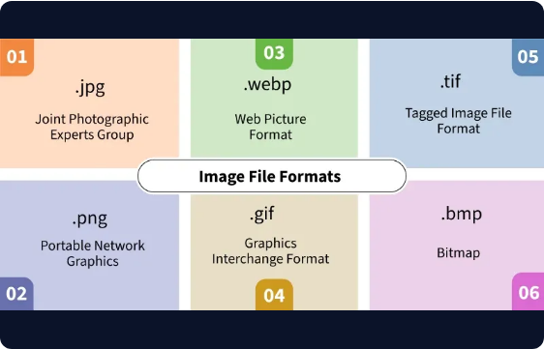
Reading & Writing Files
▸
Opening Files: Use stream constructors or file.open("data.txt", ios::app) to append new records.
▸
Writing Data: Standard insertion operators (file << "Text") format text directly into files.
▸
Reading Data: Use getline(file, line) in a while loop to read line by line until EOF.
▸
Closing Files: Always call file.close() to release file locks and flush memory buffers.

Slide 9
Basic File I/O Operations
Classes
#include <iostream>
#include <fstream>
using namespace std;
int main() {
// Create and open a text file
ofstream MyFile("filename.txt");
// Write to the file
MyFile << "Files can be tricky, but it is fun enough!";
// Close the file
MyFile.close();
}
The three main classes used for file operations are:
ofstream:
Output file stream. Used to create and write data to files.
ifstream:
Input file stream. Used to read data from files.fstream: General file stream. Capable of both reading and writing.

Slide 10
Persisting OOP Objects
Saving Objects Directly
Mode | Description
std::ios::in | Opens file for reading (default for ifstream).
std::ios::out | Opens file for writing (default for ofstream, overwrites contents).
std::ios::app | Appends new data at the end of the file.
Common File Opening Modes

Slide 11

Mini Project Idea
Input the total student count, followed by each student's name and score. Calculate and output the highest score alongside the corresponding student's name

Slide 12
Project Approach
Ask for the total number of students.
Collect each student's name and marks sequentially.
Determine and display the student who scored the highest marks.

Slide 13
Ready to Build?
You now have the roadmap and code examples to master OOP principles and File Streams in C++.

